Slide 2
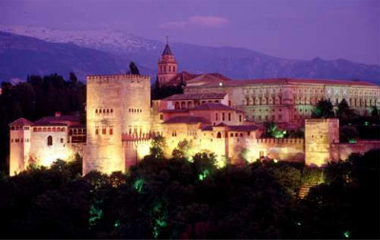
Basic elements of architecture
Alhambra Palace, Spain

Slide 3
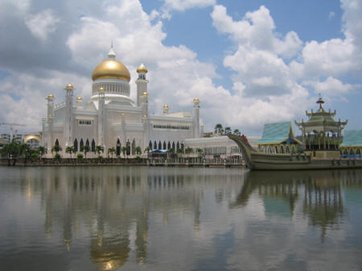
Islamic Architecture Today
Omar Ali Saifuddin Mosque, in Brunei.

Slide 4
The Blue Mosque - Istanbul
This mosque is particularly notable for its six minarets.

Slide 5
Golden temple India

Slide 6
Defined Area

Slide 7
Raised Area

Slide 8
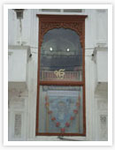
Opening

Slide 9
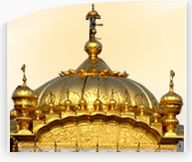
Focus

Slide 10
Focus

Slide 11
Barriers

Slide 12
Marker

Slide 13
Bridge

Slide 14
Bridge

Slide 15
Walls

Slide 16
CHINA WALL

Slide 18
Age of China Wall
The Great Wall of China was built over 2,000 years ago, by Qin Shi Huangdi, the first emperor of China, during the Qin Dynasty (221 B.C - 206 B.C.). The Great Wall was built over a period of 1000 years.

Slide 19
Dimensions 0f China Wall
The great wall is 25 feet (7.6 meters) high, 15 to 30 feet (4.6 to 9.1 meters) wide at the base, and from 9 to 12 feet (2.7 to 3.7 meters) wide at the top (wide enough for marching troops or wagons). The Great Wall stretches about 4163 miles across the North China.

Slide 20
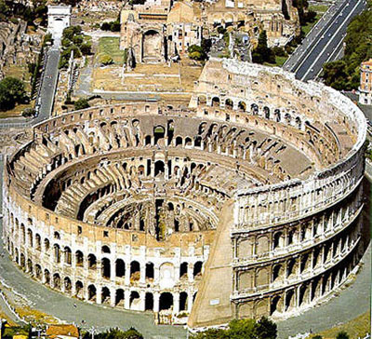
Introduction to the Colosseum.

Slide 21
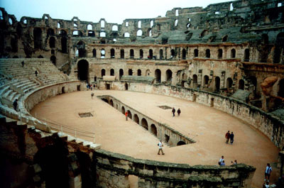
The Pit.
The space between the fighting area(arena) is for the gladiators and other animals to come out and perform for the mob.

