Slide 1
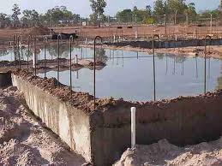
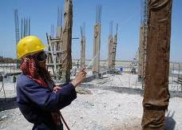
CURING CONCRETE

Slide 2
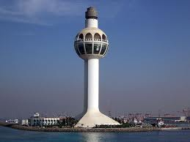
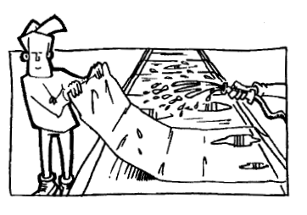
CURING CONCRETE
Presented to
Dr. Ayub Elahi
Presented by
Waqar Saleem
Muhammad Jahanzeb
Muhammad Javed
Muhammad Akmal
Umair Yaseen

Slide 3
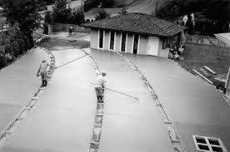
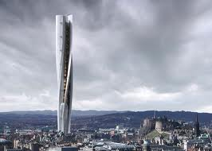
Curing Concrete ( ASTM C31)

Slide 4
Curing Concrete
What is curing??
Process to retain and maintain for a specific time
1.Moisture(not less than 80%RH)
2.Temperature(above freezing and below 176F or 80C)
Essential for cement hydration

Slide 5
Hydration
What is hydration???
It is a chemical process in which cement ingredients react with water.
Tricalcium silicate + Water--->Calcium silicate hydrate+Calcium hydroxide + heat
173.6kJ
Dicalcium silicate + Water--->Calcium silicate hydrate + Calcium hydroxide +heat
58.6KJ

Slide 6
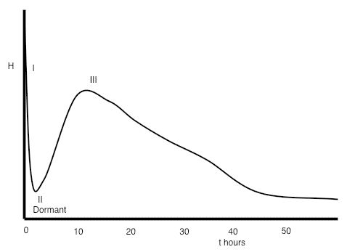
Hydration (ASTM C186)

Slide 7
Hydration (stage I)
Almost immediately on adding water
some of the clinker sulphates and gypsum dissolve
producing an alkaline, sulfate-rich, solution.
Stage I

Slide 8
Hydration (stage I)
the (C3A) phase (the most reactive of the four main clinker minerals)
reacts with the water to form an aluminate-rich gel
Stage I on the heat evolution curve

Slide 9
Hydration (stage I)
(C3A) reaction is with water is strongly exothermic
but does not last long
typically only a few minutes

Slide 10
Hydration (stage II)
Stage I is followed by a period of a few hours of relatively low heat evolution.
This is called the dormant, or induction period.
Paste becomes stiff and not workable

Slide 11
Hydration (stage III)
main period of hydration
the alite and belite in the cement start to react
formation of calcium silicate hydrate and calcium hydroxide

Slide 12
Hydration (stage III)
time concrete strengths increase
maximum heat evolution occurs typically between about 10 and 20 hours
after mixing and then gradually tails off

Slide 13
HOW TO CURE???
WHAT ARE PURPOSES OR FUNCTIONS??
????????

Slide 14
Curing methods
3 main purposes of curing
Maintaining mixing water in concrete during the early hardening process
2. Reducing the loss of mixing water from the surface of the concrete
Accelerating strength gain using heat and additional moisture

Slide 15
Maintaining mixing water
First purpose
4 ways
Ponding or immersion
Spraying or fogging
Saturated wet coverings
Left in place forms

Slide 16
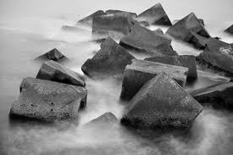
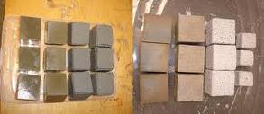
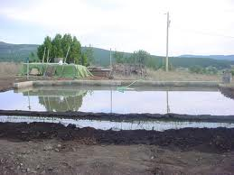
Maintaining mixing water
First purpose
First way
Ponding OR immersion

Slide 17
Maintaining mixing water
Ponding or Immersion
ASTM C192/C192M
Ideal for preventing loss of moisture
Maintain uniform temperature
Disadvantages:
Requires considerable labor and supervision
Impractical for big jobs

Slide 18
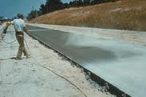
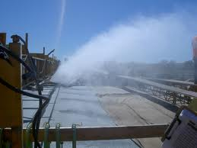
Maintaining mixing water
First purpose
2nd way
Spraying and fogging

Slide 19
Spraying or Fogging
ASTM C192
Excellent method when temperature is above freezing and humidity is low.
Disadvantages:
Cost
Water erosion of the newly finished concrete form.

Slide 20
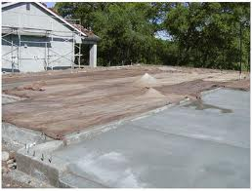
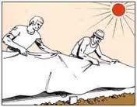
Maintaining mixing water
First purpose
3rd way
ASTM C84-36
Saturated wet covering

Slide 21
Wet coverings
Moisture-retaining fabrics saturated with water i.e burlap, cotton mats, rugs.
Advantage
1. no discoloration
2 Resistant to rot and fire
Disadvantage
Periodic additions of water
Use of polythylene film over wet covering will eliminate continuous watering
ASTM C171(MATERIAL)

Slide 22
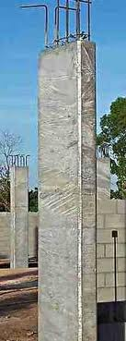
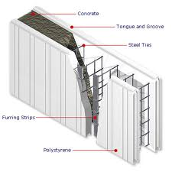
Maintaining mixing water
First purpose
4th way
Left in place forms

Slide 23
Maintaining mixing water
Left in place forms
Advantages
No extra cost or labour
Easy
Disadvantages
Risky
Extra care in hot weather
And wood forms

Slide 24
Reducing loss of water
2nd purpose
3 ways
Impervious paper
plastic sheets
Membrane-forming compounds

Slide 25
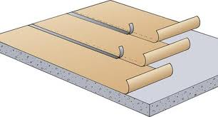
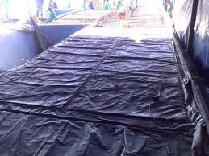
Reducing loss of water
2nd purpose
1st way
ASTM C 309. (AASHTO M 148
Covering concrete with impervious paper or plastic sheets

Slide 26
Impervious paper
Reducing loss of water
Two sheets of kraft paper cemented tegether by a bitumious adhesive with fiber reinforcment.
Advantages
Very efficient for curing horizontal surfaces
Periodic addition of water are not required
Assures suitable hydration by preventing loss of moisture
Reusable
Tears and holes can easily be repaired with patches
Disadvantage
Marginal cost
ASRM C171

Slide 27
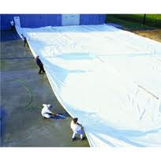
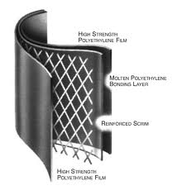
Reducing loss of water
2nd way
Plastic sheets

Slide 28
Plastic sheets
Polyethylene films, 4-mil thickness
Advantages
Lightweight
Effective moisture barrier
Easily applied to complex as well as simple shapes
Disadvantages
Can cause patchy discoloration
More pronounced when film is wrinkled
Periodic additions of water may be necessary to prevent discoloration
ASTM C 171

Slide 29
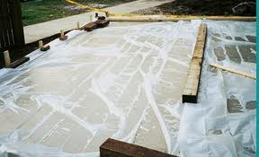
Reducing loss of water
2nd purpose
Applying membrane-forming curing compounds

Slide 30
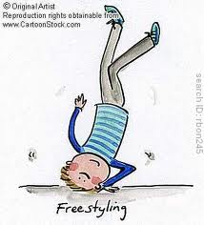
Membrane-forming compound
Liquid membrane-forming compounds use to retard or reduce evaporation of water
Waxes, resins, chlorinated rubber
Advantages
hand-operated or power-driven spray equipment
One coat 150-200 sft per gallon
Disadvantages
Extra cost
Skilled labour
ASTM C309
Efficiency check ASTM ASTM C156 - 09a

Slide 31
Accelerating strength gain
3nd purpose
4 ways
Curing steam
Heating coils
Electrical heated forms or pads
Concrete blanket

Slide 32
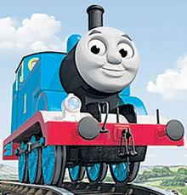
Accelerating strength gain
3nd purpose
1st way
Steam Curing
Advantageous where early strength gain is required, or
Additional heat is required to accomplish hydration, ex. cold weather.
Two Methods:
Live steam (atmospheric pressure)
Autoclave (high pressure)

Slide 33
Steam curing

Slide 34
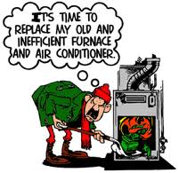
Accelerating strength gain
3nd purpose
2nd way
Heating coils
Embedded near surface of concrete elements
Prevention from freezing in cold weather

Slide 35
Accelerating strength gain
3nd purpose
3rd way
Electrical heated forms or pads
Primarily used by precast concrete producers
Now used in some sensitive projects

Slide 36
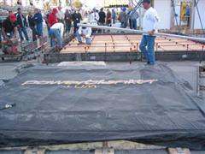
Accelerating strength gain
3nd purpose
4th way
ASTM C167
Concrete blanket
Insulate the surfaces in
cold temperatures
4300psi
9hours

Slide 37
Accelerating strength gain
Winter Concrete Curing Blankets
Prevents freezing, rapid drying, & cracking all winter
Thaw frozen ground prior to pouring
Heat spreading technology cures concrete fast
Roll it out, Plug it in, the blanket does the rest
Accelerate your construction jobs all winter
Produces ROCK-HARD concrete every time
Maintain optimal curing temperatures year-round
Only pennies a day to operate

Slide 38
Method | Advantage | Disadvantage
Sprinkling with Water or covering with Burlap | Excellent results if constantly kept wet | Likelihood of drying between sprinklings; difficult on vertical walls
Straw | Insulator in winter | Can dry out, blow away, burn
Moist earth | Cheap but messy | Stains concrete, can dry out, removal problem
Ponding on flat surfaces | Excellent results, maintain uniform temperature | Requires considerable labor, undesirable in freezing weather
Curing compounds | Easy to apply and inexpensive | Sprayer needed; inadequate coverage allows dry out; film can be broken or tracked out before curing is completed; unless pigmented allows concrete to get too hot
Water proof paper | Excellent protection prevents drying | Heavy cost can be excessive; must be kept in rolls; storage and handling problem
Plastic film | Absolutely watertight, excellent protection. Light and easy to handle | Should be pigmented for heat protection; requires reasonable care and tears must be patched; must be weighed down to prevent blowing away

Slide 39
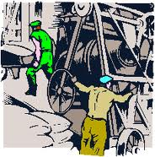
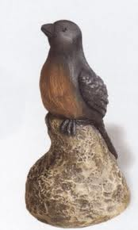
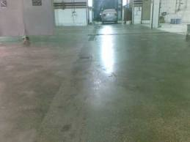
Effects on hardened concrete
Increased
Strength
Watertightness
Abrasion resistance
Freeze-thaw resistance
Volume stability

Slide 40
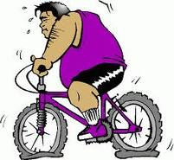
Curing tips
ample water
do not let it dry
dry concrete = dead concrete, all reactions stop
can not revitalize concrete after it dries
keep temperature at a moderate level
concrete with flyash requires longer curing

Slide 41
Temperature effects on curing
The higher the temperature the faster the curing
best temperature is room temperature
strongest concrete is made at temperature around 40 F.(not practical)
If concrete freezes during the first 24 hrs., it may never be able to attain its original properties.

Slide 42
Temperature effects

Slide 43
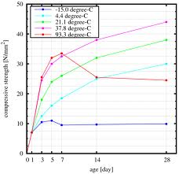
Temperature effects

Slide 44
Temperature effects on curing
real high temperatures above 120 F can cause serious damage since cement may set too fast.
accelerated curing procedures produce strong concrete, but durability might suffer.
autoclave curing.

Slide 45
Moisture tests
Polythene sheet test(ASTM D 4263)
Mat Test
Test Strip
Moisture Meters
Gravimetric

Slide 46
Thank you

