Slide 1
DRAWING PROJECT

Slide 2
PROJECT TITLE
Various Symbols And Special Lines Used In Civil Engineering Drawing

Slide 3
Submitted To:
Engr. FAWAD AHMED NAJAM
SUBMITTED BY:
2K9-SCET-29
2K9-SCET-30
2K9-SCET-31
2K9-SCET-33
2K9-SCET-34

Slide 4
SPECIAL LINES
Standard engineering drawing line types
Visible
Hidden
center
cutting plane
Break lines
Dimension and extension lines

Slide 5
LINES
Visible lines:
continuous lines used to depict edges directly visible from a particular angle.
Hidden lines:
are short-dashed lines that may be used to represent edges that are not directly visible.
Center lines
are alternately long- and short-dashed lines that may be used to represent the axes of circular features.

Slide 6
LINES
Cutting Plane:
are thin, medium-dashed lines, or thick alternately long- and double short-dashed that may be used to define sections for section views.
Break lines:
Dimension And Extension Lines:

Slide 7
LINES
Lines can also be classified by a letter classification in which each line is given a letter.
Type A lines show the outline of the feature of an object. They are the thickest lines on a drawing and done with a pencil softer than HB.
Type B lines are dimension lines and are used for dimensioning, projecting, extending, or leaders. A harder pencil should be used, such as a 2H.

Slide 8
LINES
Type C lines are used for breaks when the whole object is not shown. They are freehand drawn and only for short breaks. 2H pencil
Type D lines are similar to Type C, except they are zigzagged and only for longer breaks. 2H pencil

Slide 9
LINES
Type E lines indicate hidden outlines of internal features of an object. They are dotted lines. 2H pencil
Type G lines are used for centre lines. They are dotted lines, but a long line of 10–20 mm, then a gap, then a small line of 2 mm. 2H pencil

Slide 10
LINES
Type H lines are the same as Type G, except that every second long line is thicker. They indicate the cutting plane of an object. 2H pencil
Type K lines indicate the alternate positions of an object and the line taken by that object. They are drawn with a long line of 10–20 mm, then a small gap, then a small line of 2 mm, then a gap, then another small line. 2H pencil.

Slide 11
SYMBOLS
Definition
Shared understandings about the meaning of certain words, attributes, or objects.
Characteristics
Displacement
Our ability to understand that a certain symbol means a certain thing.
Arbitrary
A symbol has no direct connection with the thing it refers to. Meaning is a construction of the human mind.
Openness
Our ability to create and use symbols as we see fit.

Slide 12
SYMBOLS
DRAWING SYMBOLS:
Because of the small scale used in most drawings, standard graphic symbols are used to present complete information concerning construction items and materials.
These typical symbols are used so frequently in construction drawings that their meanings must be familiar not only to the preparer, but to the user as well.

Slide 13
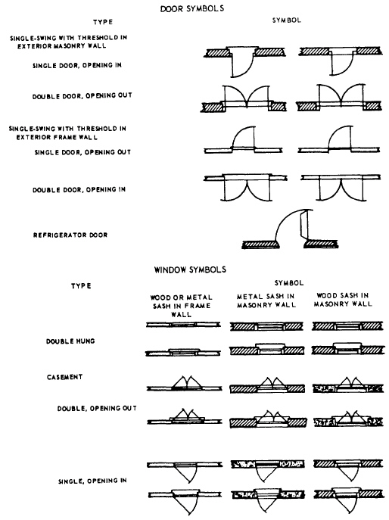
DOORS SYMBOLS

Slide 14
WINDOW SYMBOLS

Slide 15
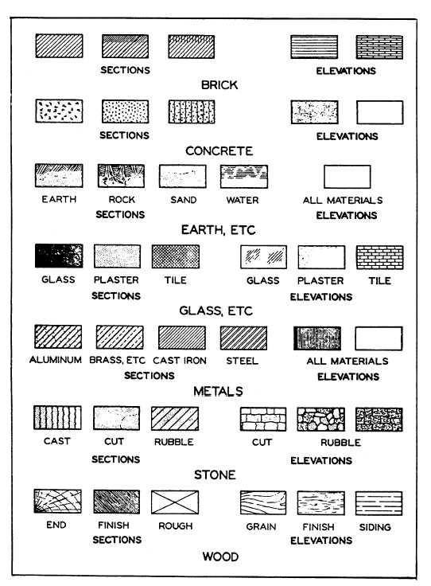
Materials symbols

Slide 16
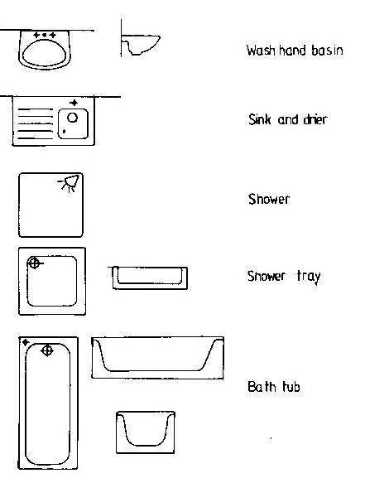
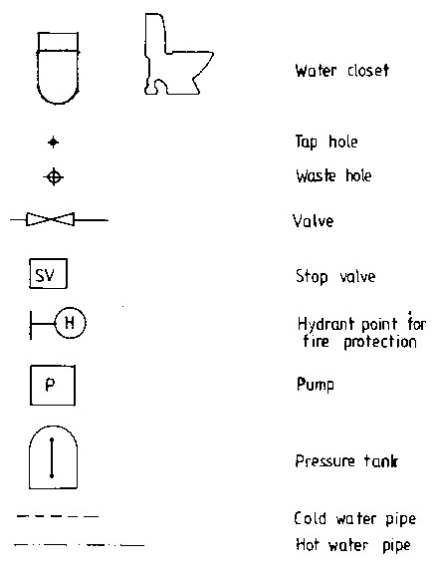
TOILET SYMBOLS

Slide 17
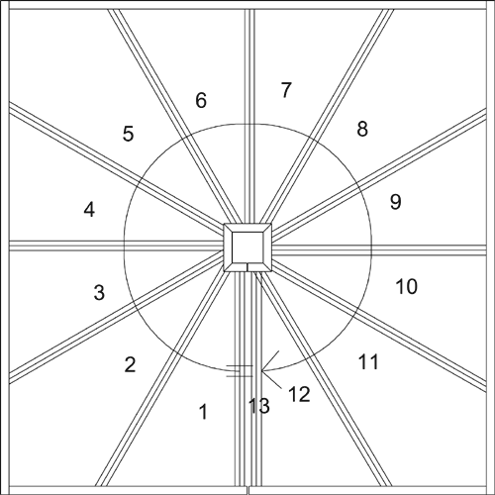
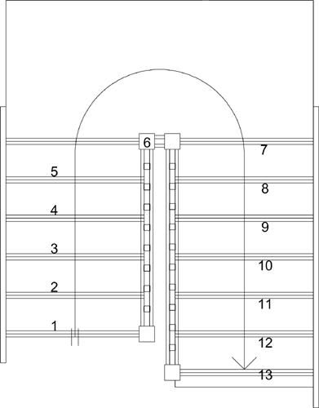
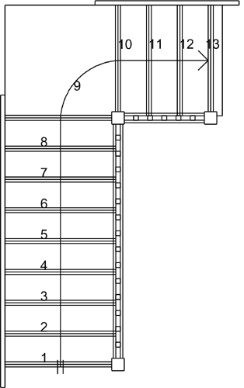
Stair Case Symbol

