Slide 2
AIRPORT
A complex of runways and buildings for the
takeoff, landing, and maintenance of civil aircraft,
with facilities for passengers

Slide 3
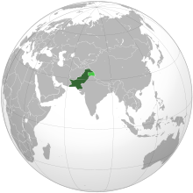
AIRPORTS IN PAKISTAN
There are an estimated 139 airfields in Pakistan. The largest airport in Pakistan is Jinnah International Airport, Karachi
In addition, the international airports at Lahore, Islamabad, Peshawar and Quetta are also major civil airports handling the majority of domestic and international civil aviation traffic in Pakistan.

Slide 4
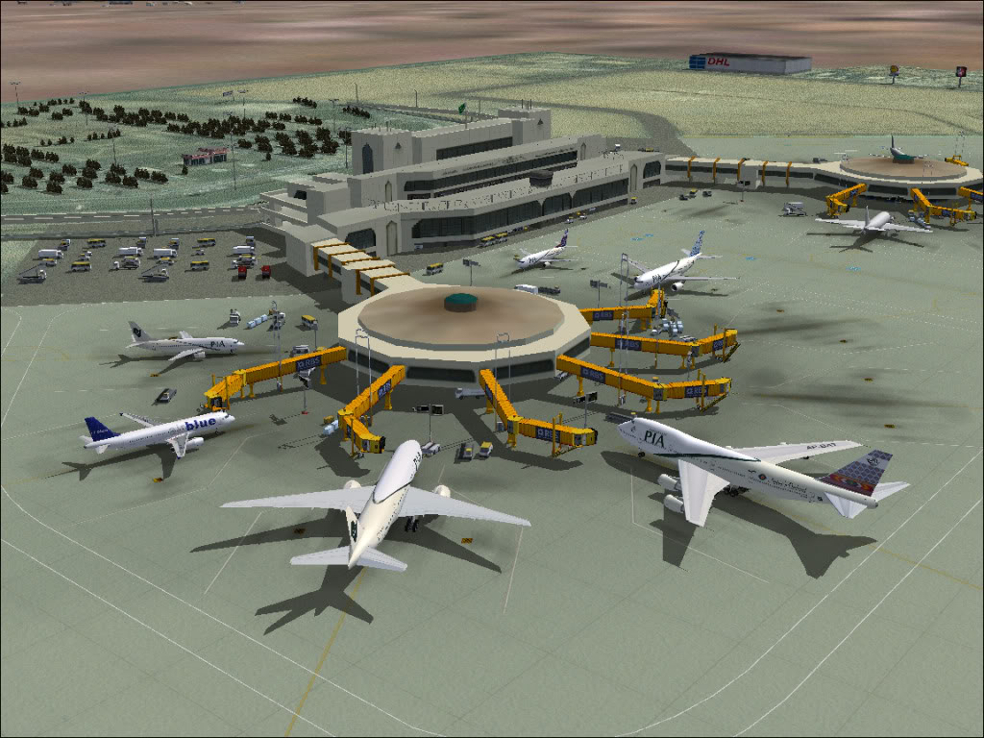
Jinnah International Airport
Can handle 42 aircraft at a time
16 passenger gates
Handles 6 million passengers annually
Capacity of handling 12 million passengers annually

Slide 5
Airports
Types of Airports
International Airports
Regional
Airports
Domestic
Airports

Slide 6
International Airports
An international airport has direct service to many other airports.
Handle scheduled commercial airlines both for passengers and cargo.
Notes:
Larger airports may have Fixed Base Operator (FBO) services, seaplane docks and ramps, air traffic control, passenger facilities such as restaurants and lounges, and emergency services.
In some jurisdictions, the term airport is used where the facility is licensed as such by the relevant government organization (e.g. Federal Aviation Administration (FAA), Transport Canada). Elsewhere the distinction is merely one of general appearance. Yet other areas define an airport by its having the necessary customs offices etc expected of a port, though the more general term is airport of entry.
Larger airports for airline flights generally have paved runways 2,000 m (6,600 ft) or longer.
In the United States, the minimum dimensions for dry, hard landing fields are defined by the FAR Landing And Takeoff Field Lengths.
These include considerations for safety margins during landing and takeoff.
Heavier aircraft require longer runways.
The longest public-use runway in the world is at Qamdo Bangda Airport in China. It has a length of 5,500 m (18,045 ft). The world’s widest paved runway is at Ulyanovsk Vostochny Airport in Russia and is 105 m (344 ft) wide.

Slide 7
Domestic Airports
A domestic airport is an airport which handles only domestic flights or flights within the same country.
Domestic airports don't have customs and immigration facilities and are therefore incapable of handling flights to or from a foreign airport.

Slide 8
Regional Airports
A regional airport is an airport serving traffic within a relatively small or lightly populated geographical area.
A regional airport usually does not have customs and immigration facilities to process traffic between countries.

Slide 9
Components of Airport
Terminal Building (T.B)
Apron
Runways
Taxiways
Hangers

Slide 10
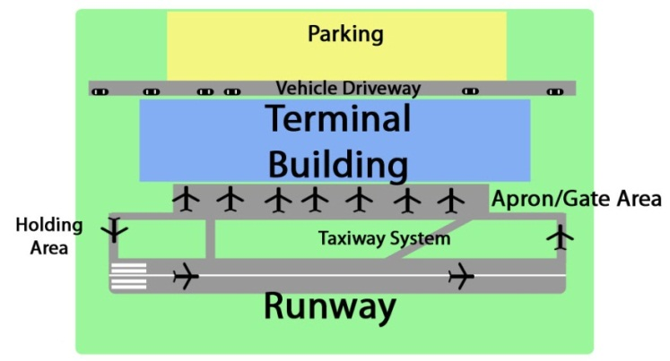

Slide 11
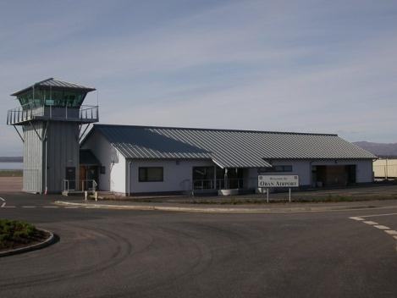
Terminal Building (T.B)
Provides facilities for all passenger arriving and departuring from airport and allowed airline and admin’s personnel's. It includes followings facilities:
1. Booking office 2. Custom’s office
3. Restaurants 4. Weather bureau
5. Luggage and mails rooms
6. Communication systems (telephone/telegraph office etc.)
7. Air traffic control tower

Slide 12
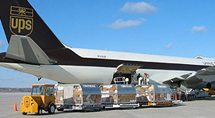
Apron
Portion of the airport usually paved in front of TB, mean for parking, loading/unloading of aircraft.

Slide 13
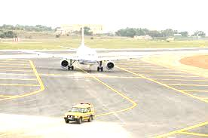
Taxiways
Path on an airport connecting runways with ramps, hangers, terminals and other facilities.
They mostly have hard surface such as asphalt or concrete, although smaller airports sometimes use gravel or grass.

Slide 14
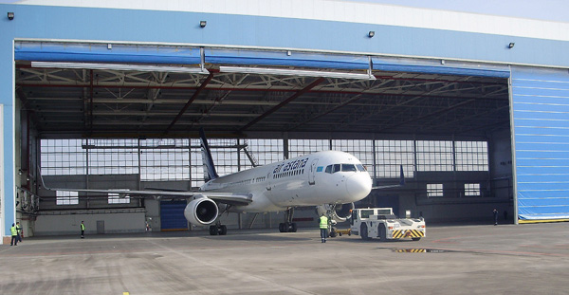
Hangers
Large sheds erected on airport for housing & repairing airplanes. It may be storage or service hangers

Slide 15
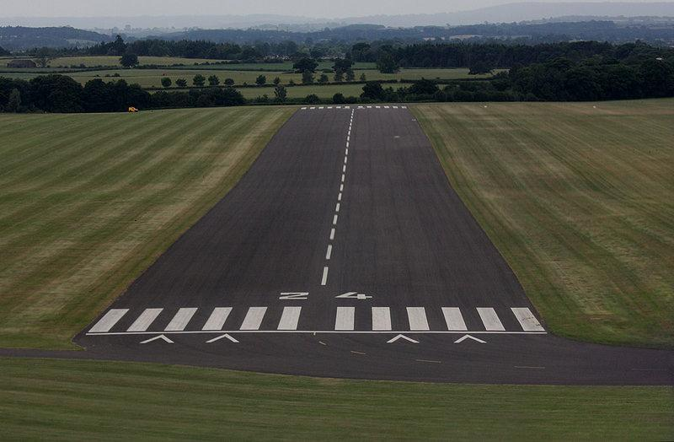
Runways
Rectangular area on a land prepared for the landing and takeoff of aircraft".
Runways may be a man-made surface (often asphalt, concrete, or a mixture of both) or a natural surface (grass, dirt, gravel, ice, or salt).

Slide 16
Classification of Runways
There are two main types
1. Primary runways
The runway that is oriented into prevailing winds
2. Crosswind runways
The runway that is oriented toward the most common crosswind direction

Slide 17
Runways
Single Runways
Parallel Runways
Open-V Runways
Intersecting Runways

Slide 18
Single
Parallel

Slide 19
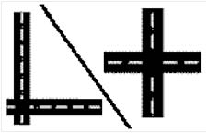
Open-V
Intersecting Runways

Slide 20
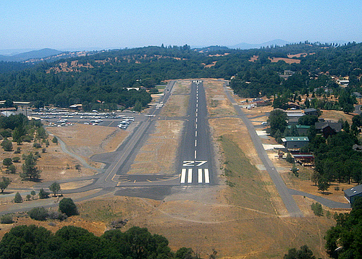
Runways Orientation
Runways are define/identified by its orientation w.r.t magnetic North .
eg. 270 degree runway is Runway 27 or R 27

Slide 21
Runways Orientation
If the orientation of runway is 90 degree w.r.t magnetic North represent as R 09

Slide 22
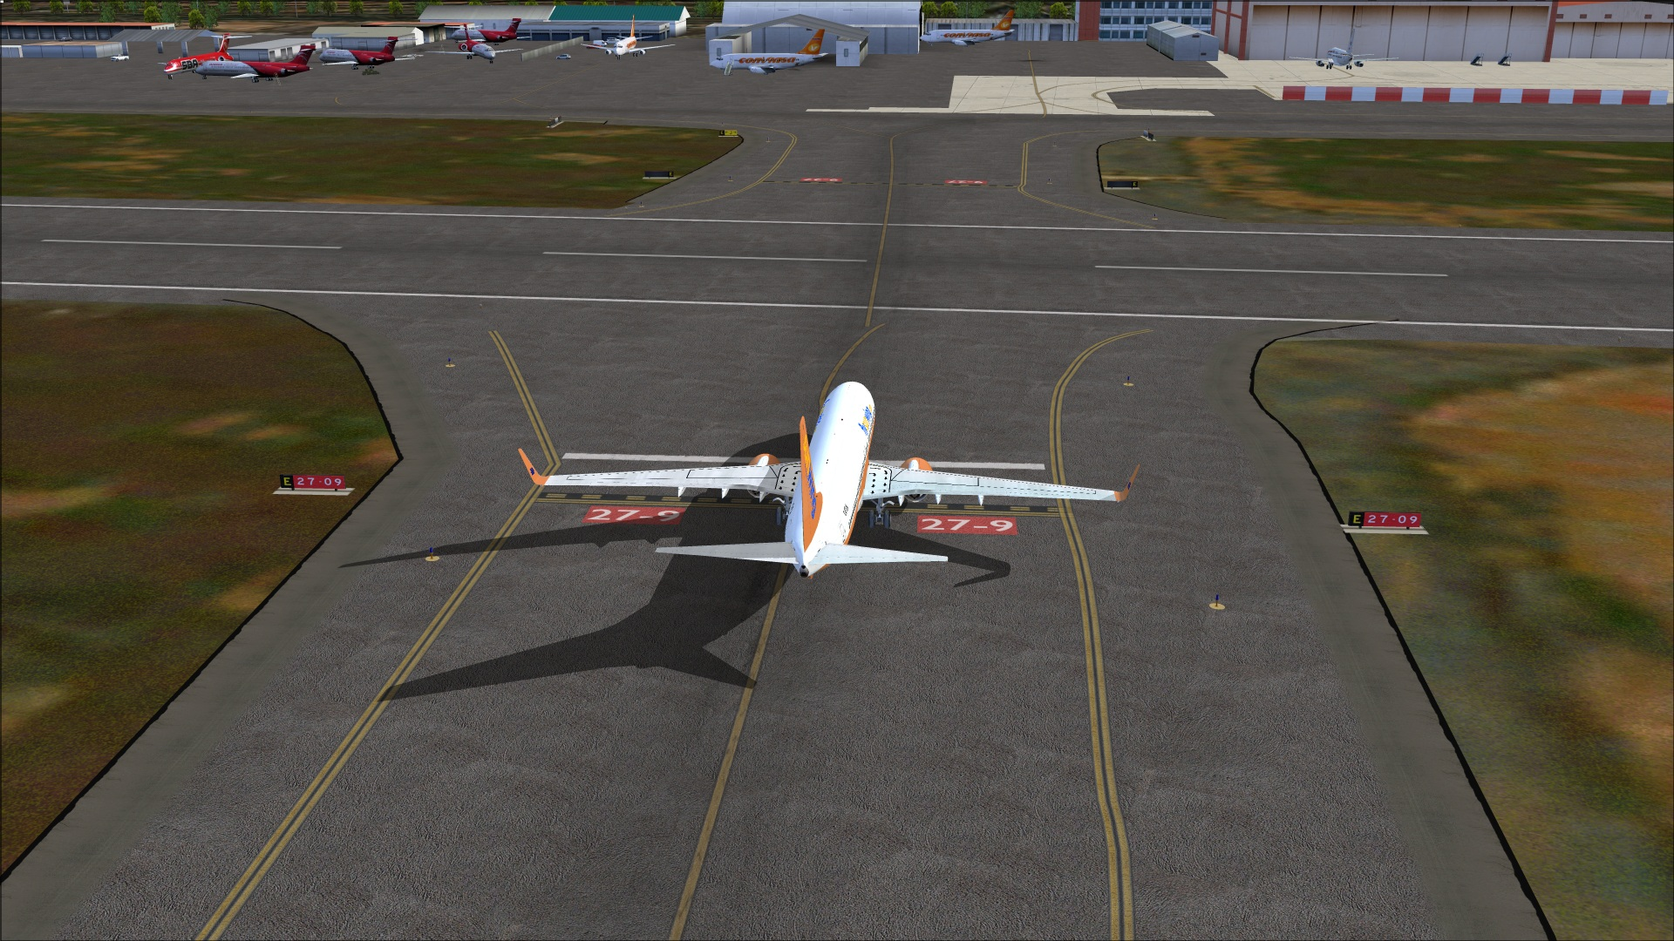
When the same runway is used form opposites directions the runway is identified by both direction eg. R 09/27

