Slide 2
By Dr. Attaullah Shah Swedish College of Engineering and Technology Wah Cantt.
Reinforced Concrete Design-2
Introduction

Slide 5
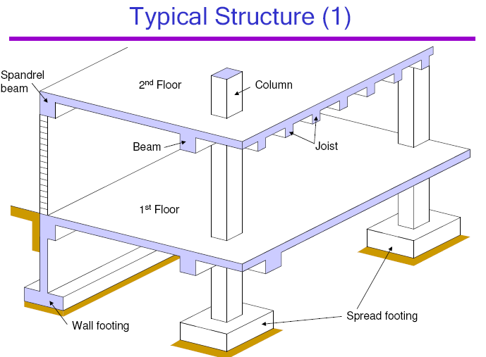

Slide 6
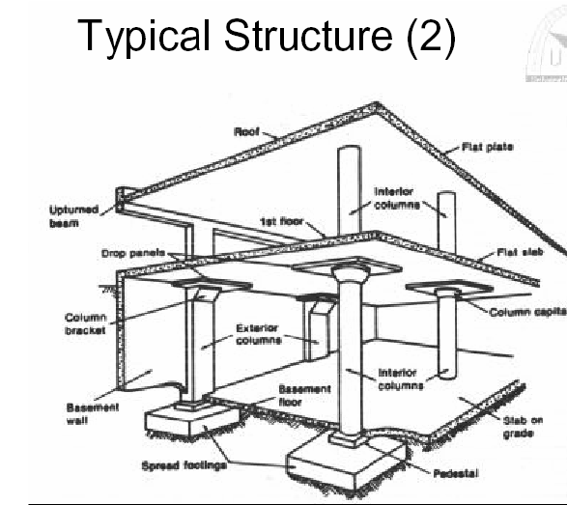

Slide 14
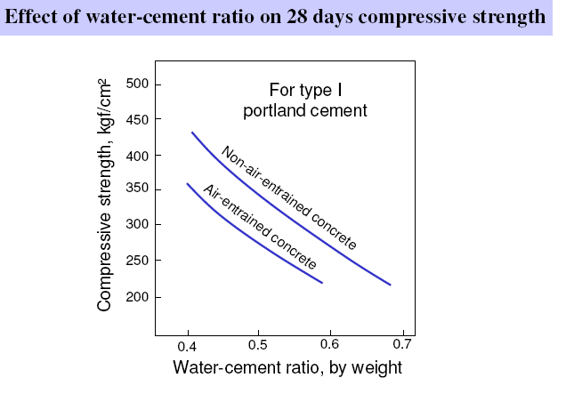

Slide 19
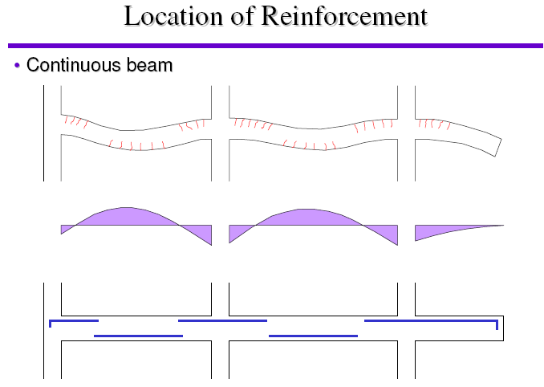

Slide 22
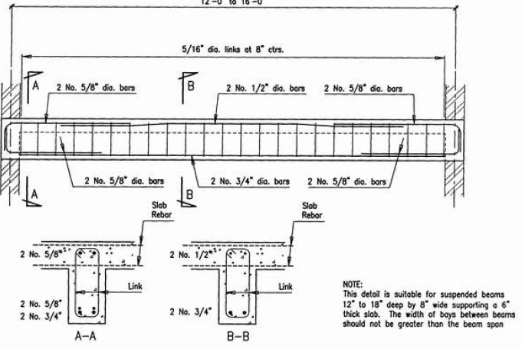

Slide 23
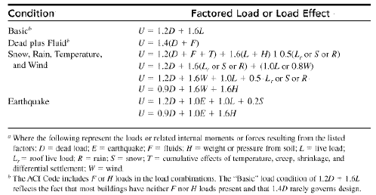
Load Combinations

Slide 24
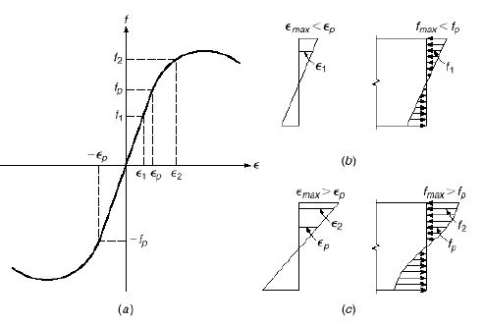
Fundamental Assumption in RCC design
1. A cross section that was plane before loading remains plane under load means that the stain in beam is proportional to the distance from the axis.
2. Within the proportionality limit, the stress at the in a fiber is proportional to distance of the point from neutral axis. Beyond this point, the stress at any point is equal to stress corresponding to the strain at that point on stress strain diagram.
3. The distribution of shear stress depends on the stress strain diagram and shape of the cross sec. The shear stress is largest at the neutral axis and zero at the outer fiber.
4. Due to combined effect of normal and shear stresses, the inclined stresses in compression and tension result. The maximum inclined stress is given as t= f/2 + √f /4 +ν² where f = intensity of normal fiber stress and v= intensity of tangential stress
5. When the stresses in the outer fibers are less than proportionality limit, then the beam behaves elastically.
- The neutral axis passes through the centre of gravity of the section.
- The bending stresses are proportional to the distance from the neutral axis

Slide 25
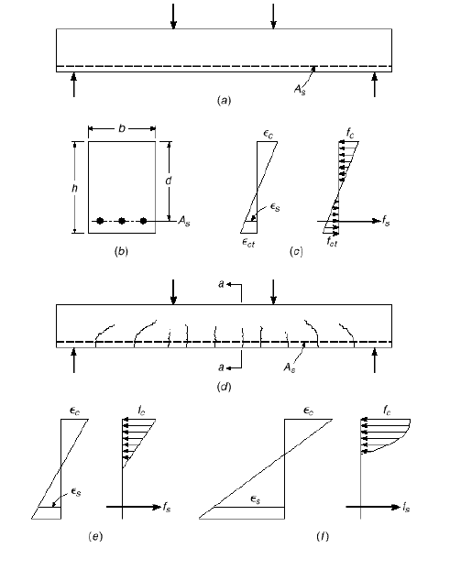
Behavior of Reinforced Concrete beams

Slide 26
The bending stress at any point of the cross section is given as:
The maximum bending stress at the outer fiber is given as:
Where c:distance from n.a and c/I is sectional Moduls S
The shear stress at any point is given as: v = VQ/Ib

Slide 27
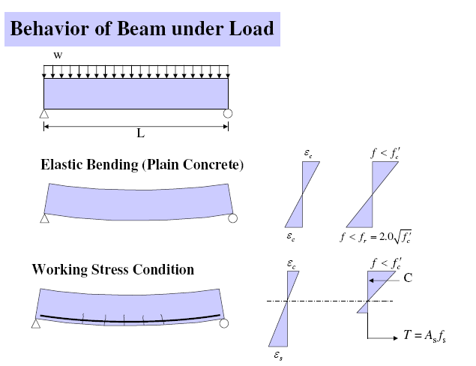

Slide 28
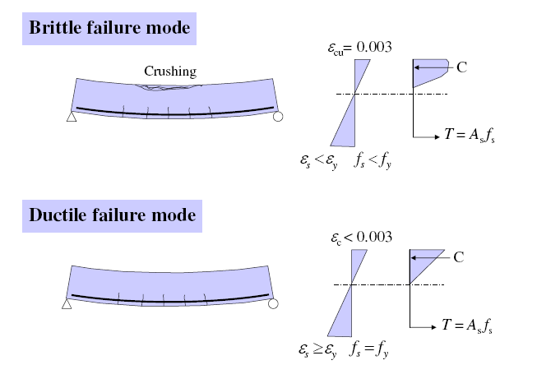

Slide 29
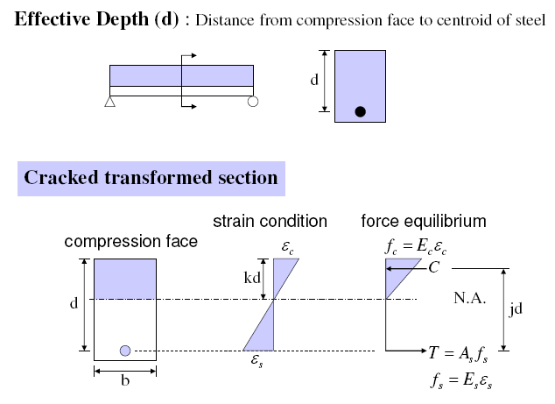

Slide 30
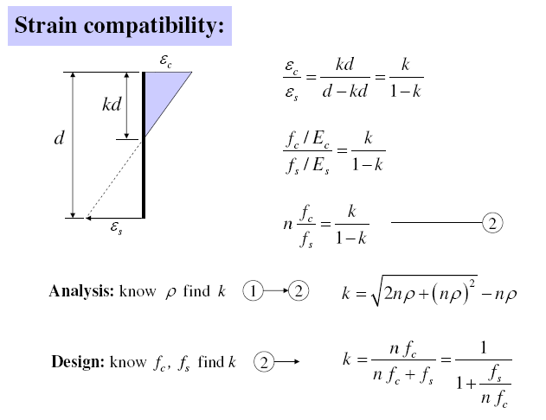

Slide 32
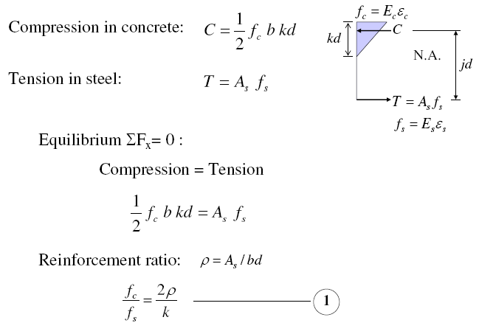

Slide 33
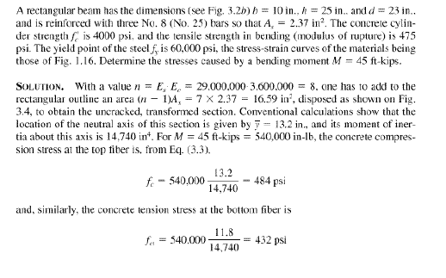
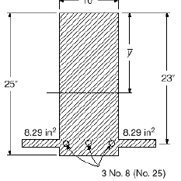

Slide 34
