Slide 1
Solid waste management
Bibhabasu Mohanty
Asst. Prof.
Dept. of civil Engineering
SALITER, Ahmedabad

Slide 2
Content…
Solid Waste Management: Quantity, Composition and characteristics of solid waste, Methods of solid waste collection, conveyance, treatment and disposal.

Slide 3
In a nutshell “ Solid waste can be regarded as refuse or waste from any kind of source”. But any refuse or waste can be economic resource to others.

Slide 4
Basic terms related to solid waste
Ash : the non-combustible solid by-products of incineration or other burning process.
Bulky waste: large wastes such as appliances, furniture, and trees and branches, that cannot be handled by normal MSW processing methods.
Co-disposal: the disposal of different types of waste in one area of a landfill or dump. For instance, sewage sludges may be disposed of with regular solid wastes.

Slide 5
4. Biodegradable material : any organic material that can be broken down by microorganisms into simpler, more stable com-pounds. Most organic wastes (e.g., food, paper) are biodegradable.
5. Compost : the material resulting from com posting. Compost, also called humus, is a soil conditioner and in some instances is used as a fertilizer.
6. Composting : biological decomposition of solid organic materials by bacteria, fungi, and other organisms into a soil-like product.

Slide 6
7. Disposal : the final handling of solid waste, following collection, processing, or incineration. Disposal most often means placement of wastes in a dump or a landfill.
8. Environmental impact assessment (EIA) : an evaluation designed to identify and predict the impact of an action or a project on the environment and human health and well-being. Can include risk assessment as a component, along with economic and land use assessment.

Slide 7
9. Environmental risk assessment (EnRA) : an evaluation of the interactions of agents, humans, and ecological resources. Comprised of human health risk assessment and ecological risk assessment, typically evaluating the probabilities and magnitudes of harm that could come from environmental contaminants.

Slide 8
10. Garbage : in everyday usage, refuse in general. Some MSWM manuals use garbage to mean "food wastes," although this usage is not common.
11. Landfilling : the final disposal of solid waste by placing it in a controlled fashion in a place intended to be permanent. The Source Book uses this term for both controlled dumps and sanitary landfills.

Slide 9
12. Leachate : liquid that has seeped through a landfill or a compost pile and has accumulated bacteria and other possibly harmful dissolved or suspended materials.
13. MSW : municipal solid waste.
14. MSWM : municipal solid waste management.

Slide 10
15. Putrescible : subject to decomposition or decay. Usually used in reference to food wastes and other organic wastes that decay quickly.
16. Refuse : all kinds of wastes in solid state excepting excreta from residential, commercial and industrial area.

Slide 11
17. Refuse-derived fuel (RDF) : fuel produced from MSW that has undergone processing. Processing can include separation of recyclables and non-combustible materials, shredding, size reduction, and pelletizing.
18. Rubbish : a general term for solid waste. Sometimes used to exclude food wastes and ashes.

Slide 12
19. Waste-to-energy (WTE) plant : a facility that uses solid waste materials (processed or raw) to produce energy. WTE plants include incinerators that produce steam for district heating or industrial use, or that generate electricity; they also include facilities that convert landfill gas to electricity.

Slide 13
Kinds of Wastes
Solid wastes: domestic, commercial and industrial wastes especially common as co-disposal of wastes
Examples: plastics, containers, bottles, cans, papers, scrap iron, and other trash
Liquid Wastes: wastes in liquid form
Examples: domestic washings, chemicals, oils, waste water from ponds, manufacturing industries and other sources

Slide 14
Classification of Wastes according to their Properties
Bio-degradable
can be degraded (paper, wood, fruits and others)
Non-biodegradable
cannot be degraded (plastics, bottles, old machines,
cans, containers and others)

Slide 15
Classification of Wastes according to their Effects on Human Health and the Environment
Hazardous wastes
waste that is reactive, toxic, corrosive, or otherwise dangerous to living things and/or the environment. Many industrial by-products are hazardous.
Non-hazardous
Substances safe to use commercially, industrially, agriculturally, or economically.

Slide 16
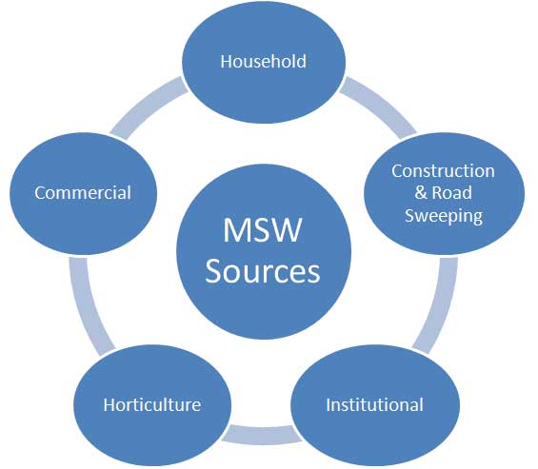
From where these comes???

Slide 17
Solid Waste in India
7.2 million tonnes of hazardous waste
One Sq km of additional landfill area every-year
Rs 1600 crore for treatment & disposal of these wastes
In addition to this industries discharge about 150 million tonnes of high volume low hazard waste every year, which is mostly dumped on open low lying land areas.
Source: Ministry of Environment & Forest

Slide 18
Growth of Solid Waste In India
In 1981-91, population of Mumbai increased from 8.2 million to 12.3 million
During the same period, municipal solid waste has grown from 3200 tonnes to 5355 tonnes, an increase of 67%
Waste collection is very low for all Indian cities
City like Bangalore produces 2000 tonnes of waste per annum, the ever increasing waste has put pressure on hygienic condition of the city
Source: The Energy & Resources Institute, New Delhi

Slide 19
Estimated waste generation is 1,00,000 MT/day.
Per capita waste generation ranges between 0.20 to 0.60 kg.
Waste collection efficiency in bigger sized cities ranges from 70 to 90% and in small sized towns it is up to 50-60%.
Local authorities spend less 5% of their budget on waste disposal and maximum cost is incurred on street sweeping and collection and transportation of waste.

Slide 20
S.No | City | Municipal solid Waste (TPD) | Per capita waste (Kg/day)
1. | Ahmadabad | 1,683 | 0.585
2. | Bangalore | 2,000 | 0.484
3. | Bhopal | 546 | 0.514
4. | Bombay | 5,355 | 0.436
5. | Calcutta | 3,692 | 0.383
6. | Coimbatore | 350 | 0.429
7. | Delhi | 4,000 | 0.475
8. | Hyderabad | 1,566 | 0.382
9. | Indore | 350 | 0.321
10 | Jaipur | 580 | 0.398
11 | Kanpur | 1,200 | 0.640
12 | Kochi | 347 | 0.518
13 | Lucknow | 1,010 | 0.623
14 | Ludhiana | 400 | 0.384
15 | Madras | 3,124 | 0.657
16 | Madurai | 370 | 0.392
17 | Nagpur | 443 | 0.273
18 | Patna | 330 | 0.360
19 | Pune | 700 | 0.312
20 | Surat | 900 | 0.600
21 | Vadodara | 400 | 0.389
22 | Varanasi | 412 | 0.400
23 | Visakhapatnam | 300 | 0.400

Slide 21
MAJOR DEFICIENCIES
Littering of garbage due to unorganized primary collection
Provision and operation of interim storage facilities unsatisfactory
Irregular garbage lifting
Transportation system not synchronize with storage facilities
Processing/ treatment of MSW not practiced
Final disposal through dumping and not SLF

Slide 22
Effects of waste if not managed wisely
Affects our health
Affects our socio-economic conditions
Affects our coastal and marine environment
Affects our climate

Slide 23
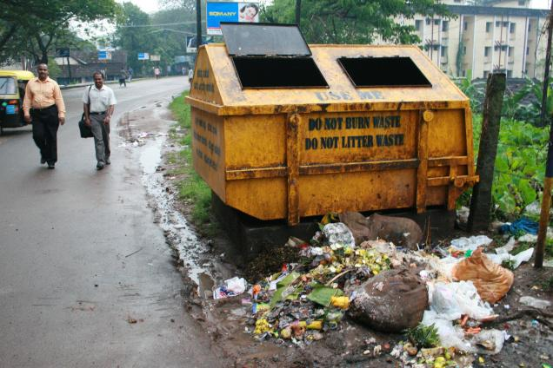
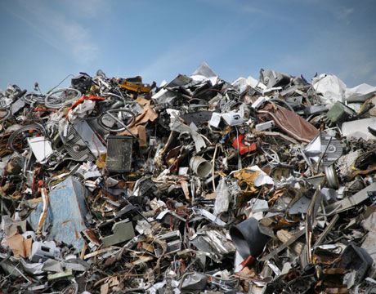
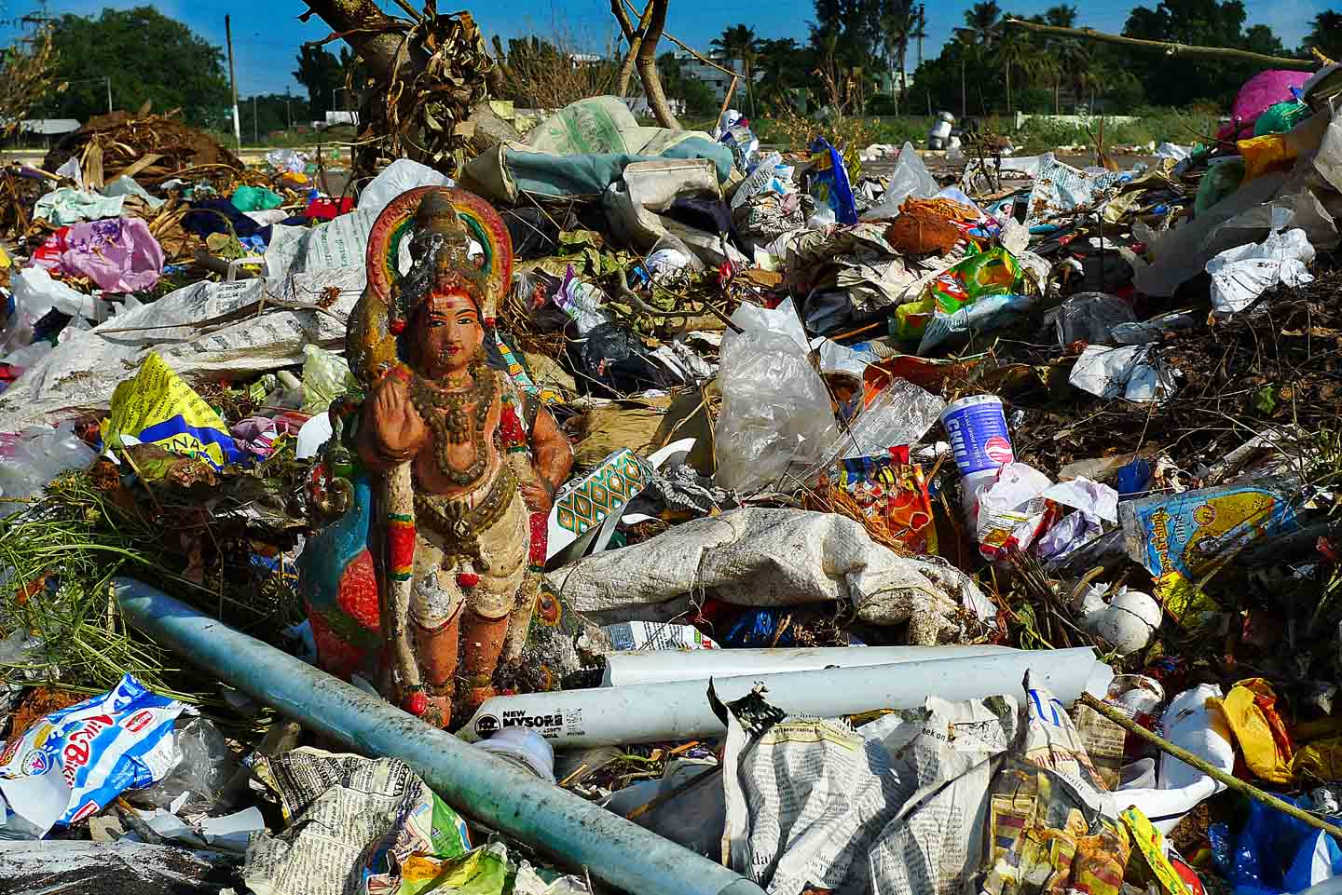
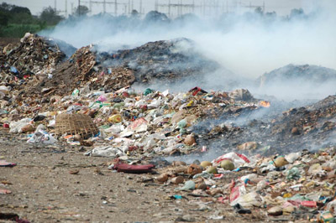

Slide 24
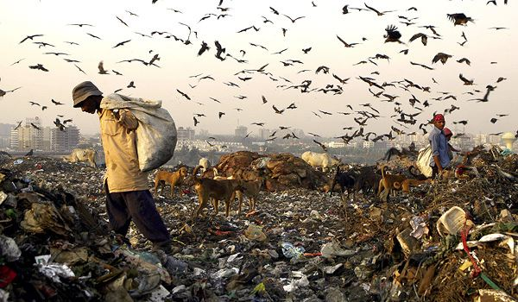
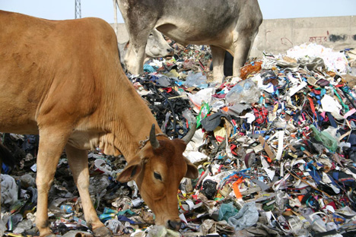

Slide 25
Composition of solid waste
The general composition of solid waste being generated from the cities of India is 40% Food & Garden waste, 5% glass & Ceramics, 3% Metal, 15% inert, 4% Plastic/ Rubber, 6 % Textile, 27 % Paper.
Total Organic Fraction - 40%, Combustible Fraction - 37%, Recyclables - 8%, Inert - 15%

Slide 26
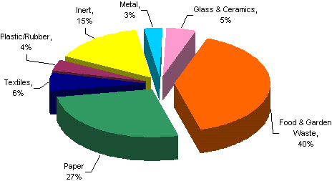
Source: CPHEEO Manual on MSW, 2005

Slide 27
Characteristics of solid waste
Three types of characteristics:
Physical
Chemical and
Biological

Slide 28
Physical characteristics
This includes the determination of percent contents of various ingredients of the solid waste.
Bulk Density is generally calculated.
Function of location, season, storage time, equipment used, processing (compaction, shredding, etc.)
Used in volume calculations.

Slide 29
Chemical characteristics
Used primarily for combustion and waste to energy (WTE) calculations but can also be used to estimate biological and chemical behaviours.
Waste consists of combustible (i.e. paper) and non-combustible materials (i.e. glass).

Slide 30
Proximate Analysis
Loss of moisture (temp held at 105 C)
Volatile Combustible Matter (VCM) (temp increased to 950 C, closed crucible)
Fixed Carbon (residue from VCM)
Ash (temp = 950C, open crucible)
Fusing Point of Ash
Clinker (agglomerations of carbon and metals) formation temperature, 2000 to 2200 F
Ultimate Analysis
Molecular composition (C, H, N, O, P, etc.)
Energy Content
Determined through lab calculations using calorimeters

Slide 31
Biological characteristics
Biodegradability
Organic fraction often equated with the volatile solids (VS) content of the waste
However, not all organic materials are easily degradable
Biodegradable fraction -
Degradation produces odours
Hydrogen sulfide, H₂S (rotten eggs)
Methyl mercaptans
Aminobutyric acid
Methane is odourless.
Attracts flies, vermin, rodents (vectors)

Slide 32
Solid waste collection and transport
Factors considered:
i) Types of Containers:
Depend on:
characteristics of SW collected
E.g. Large storage containers (Domestic SW: flats/apartment)
Containers at curbs
Large containers on a roller (Commercial/Industrial)
Collection frequency
Space available for the placement of containers

Slide 33
- Residential; refuse bags (7 -10 litres)
- Rubbish bins - 20 -30 litres
- Large mechanical containers - more commonly used to cut costs (reduce labor, time , & collection costs)
- must be standardized to suit collection equipment.

Slide 34
ii) Container Locations:
- side/rear of house
- alleys
- special enclosures (apartment/condos)
Basement (apts. in foreign countries)/ newer complexes
iii) Public Health:
relates to on-time collection to avoid the spread of diseases by vectors, etc.
iv) Aesthetics:
- must be pleasing to the eye (containers must be clean, shielded from public’s view).

Slide 35
v) Collection of SW
- 60-80 percent of total SWM costs.
- Malaysia (other developing nations) - labor and capital intensive.
- Major problems:
Poor building layouts - e.g. squatters
Road congestion - time cost, leachate, transport costs.
Physical infrastructure
Old containers used (leaky/ damaged)
Absence of systematic methods (especially at apartments, markets with large wst. volume).

Slide 36
Collections were made by:
Municipal/ District Council
Private firm under contract to municipal
Private firm contract with private residents

Slide 37
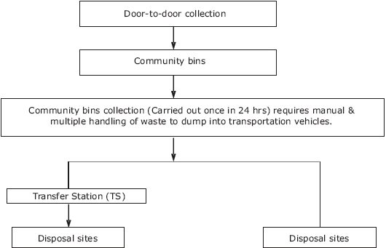

Slide 38
Types of collection
Municipal Collection Services:
a. Residential:
Curb (Kerb-side)
Alley
Set out and set back
Backyard collection

Slide 39
Curb (Kerb-side)
House owner is responsible for placing solid waste containers at the curb on scheduled day.
The work man come, collect and empty the container and put back at the curb.
House owner is required to take back the empty containers from the curb to his house.
Quickest/ economical
Crew: 1 driver + 1 or 2 collectors
No need to enter property

Slide 40
Set-out, set back
Collectors have to enter property
Set out crew carries full containers from resident storage location to curb/ alley before collection vehicle arrives.
Collection crew load their refuse into vehicle
Set-back crew return the container to storage area.

Slide 41
Alley service
The containers are placed at the alley line from where they are picked up by workmen from refuse vehicles who deposit back the empty container.

Slide 42
Backyard service
The workers with the vehicles carry a bin, wheel – barrow or sack or cloth to the yard and empty the solid waste container in it.
The bin is taken to solid waste vehicles where it is emptied.

Slide 43
Commercial-Industrial Collection Services:
i. Large movable and stationary containers
ii. Large stationary compactors (to form bales)

Slide 44
Collection Frequency:
residential areas : everyday/ once in 2 days
communal/ commercial : daily
food waste - max. period should not exceed :
the normal time for the accumulation of waste to fill a container
the time for fresh garbage to putrefy and emit fouls odor
the length of fly-breeding cycle ( < 7 days).

Slide 45
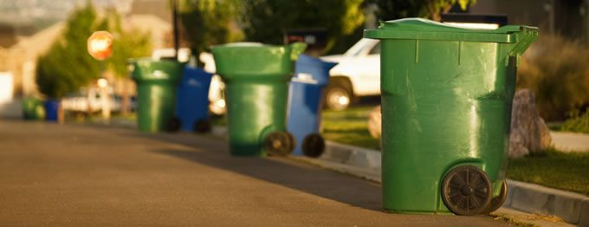
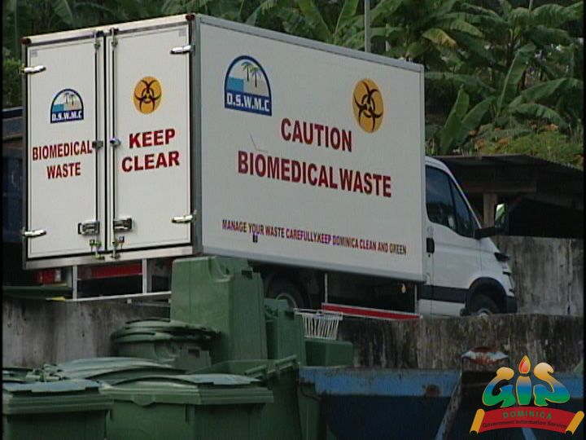

Slide 46
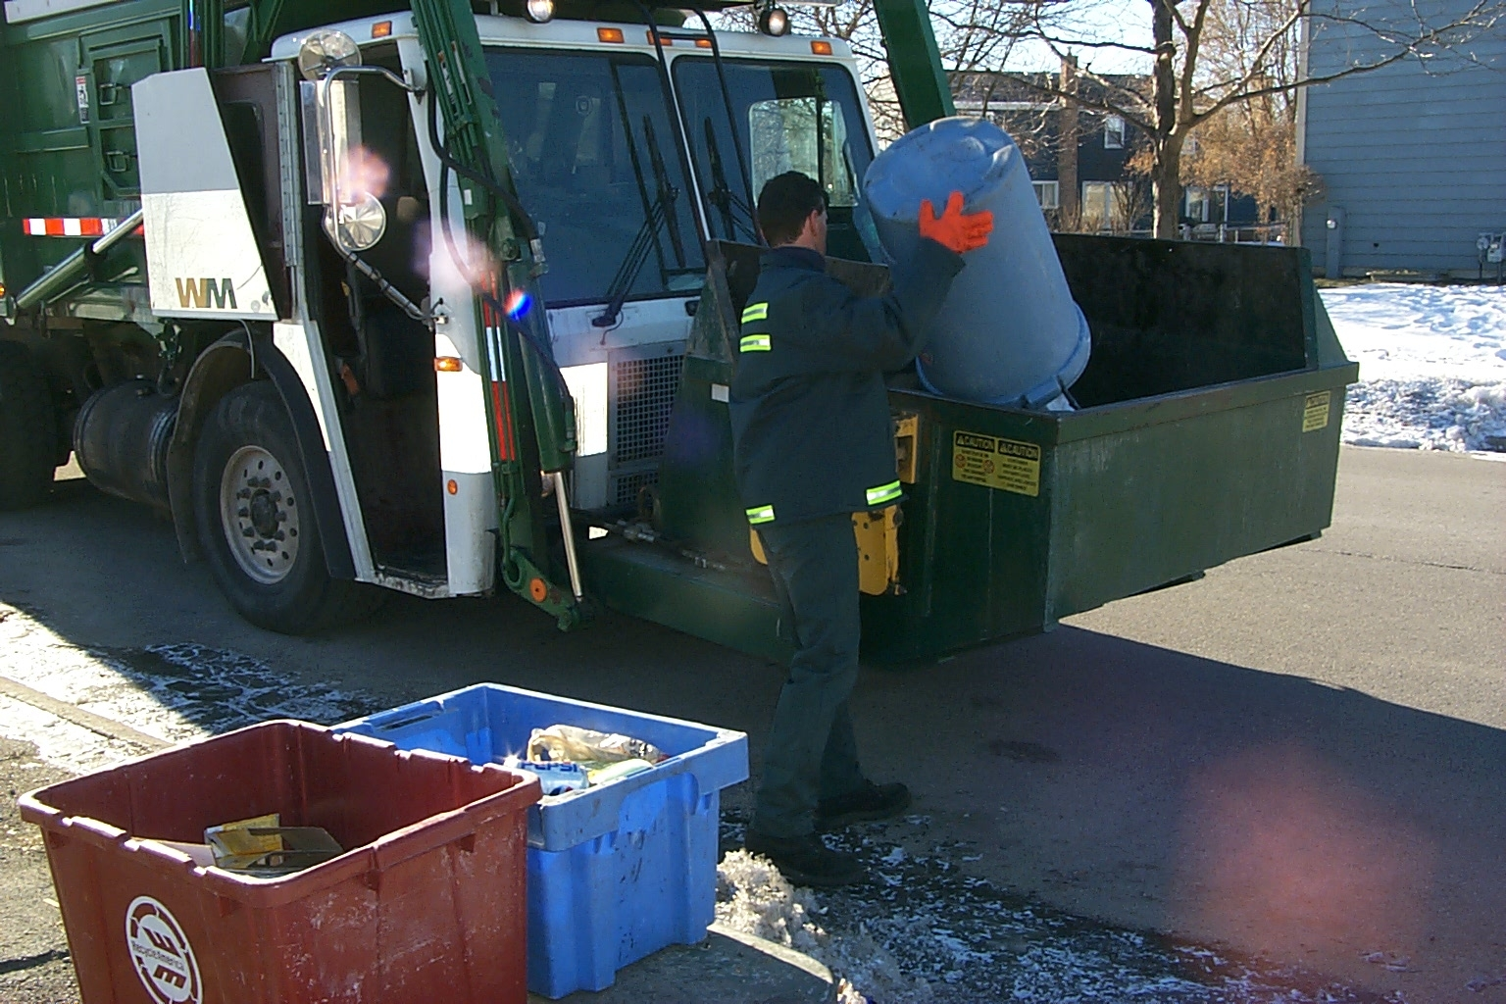

Slide 47
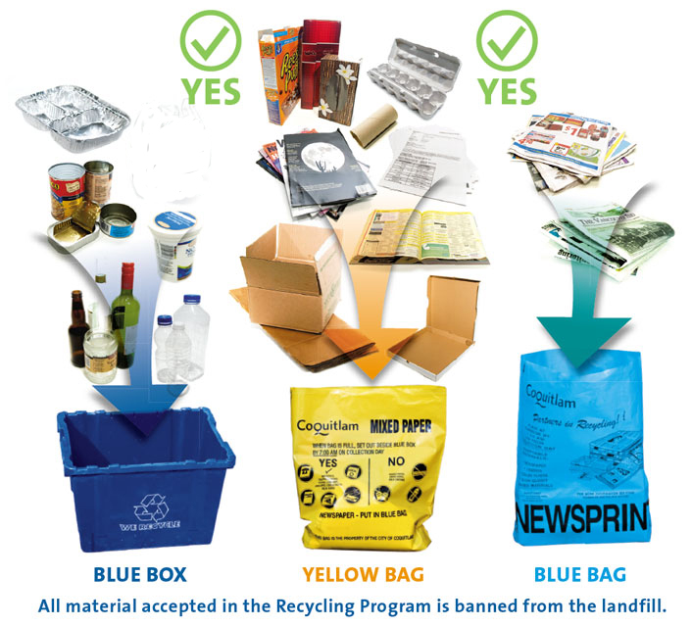

Slide 48
Treatment and disposal of solid waste
Several methods are used for treatment and disposal. These are:
Composting
Incineration
Landfilling
Pyrolysis
Recycling

Slide 49
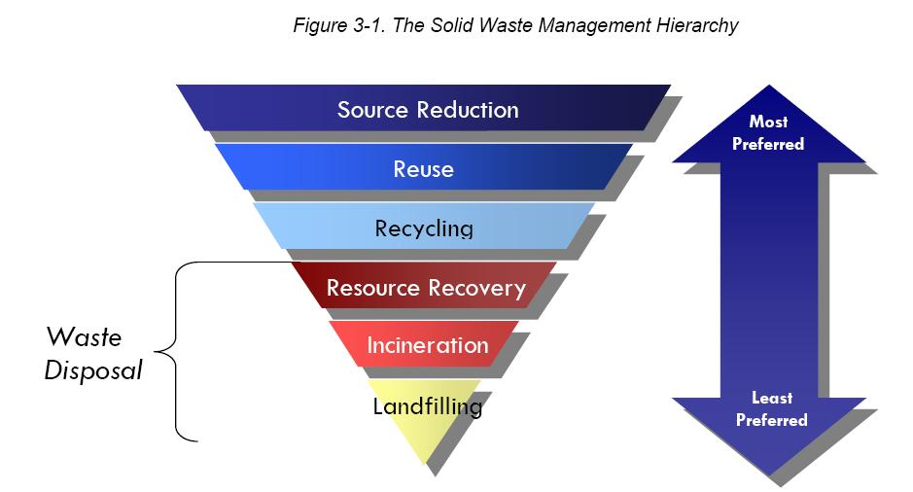

Slide 50
Composting
It is a process in which organic matter of solid waste is decomposed and converted to humus and mineral compounds.
Compost is the end product of composting, which used as fertilizer.
Three methods of composting:
(a) composting by trenching
(b) open windrow composting
(c) mechanical composting

Slide 51
Composting by trenching
Trenches 3 - 12 m long, 2 – 3 m wide and 1- 2 m deep with spacing 2 m.
Dry wastes are filled up in 15 cm. On top of each layer 5 cm thick sandwiching layer of animal dung is sprayed in semi liquid form.
Biological action starts in 2- 3 days and decomposition starts.
Solid waste stabilize in 4- 6 months and changed into brown colored odorless powdery form known as humus.

Slide 52
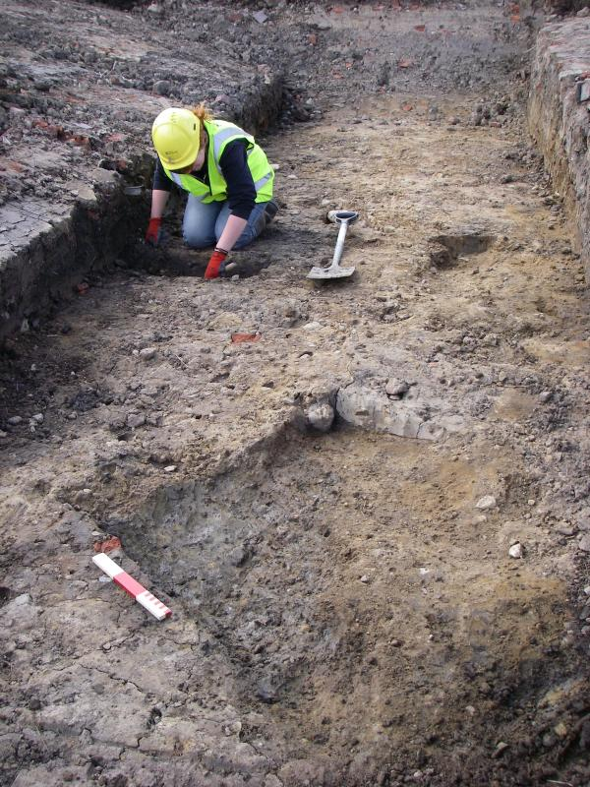
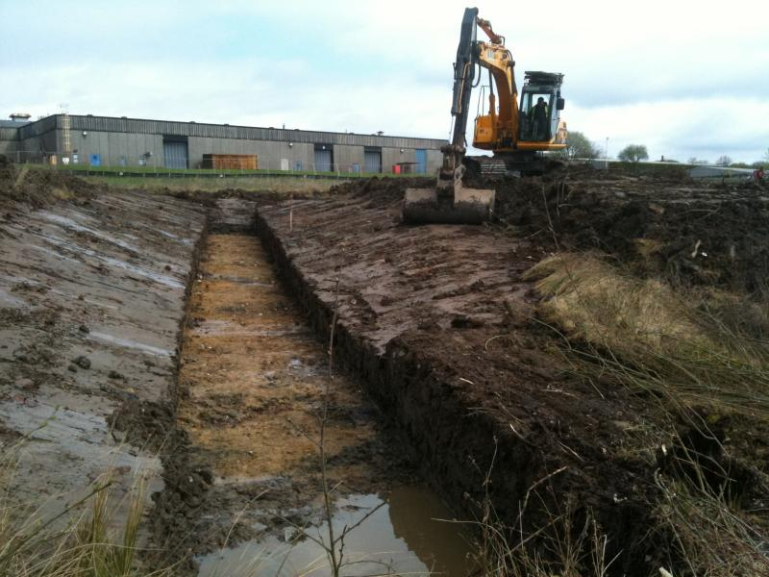

Slide 53
Open windrow composting
Large materials like broken glass, stone, plastic articles are removed.
Remaining solid wastes is dumped on ground in form of piles of 0.6 – 1 m height.
The width and length of piles are kept 1- 2 m and 6 m respectively.
Moisture content maintained at 60%.
Temp. increases in side pile.
After pile for turned for cooling and aeration to avoid anaerobic decomposition.
The complete process may take 4- 6 week.

Slide 54
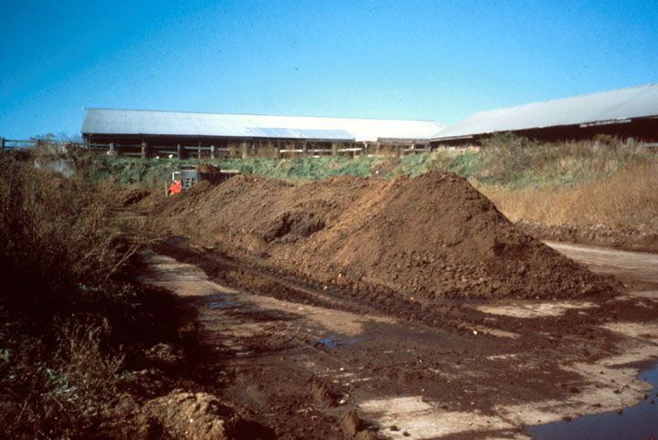

Slide 55
Mechanical composting
It requires small area compare to trenching and open windrow composting.
The stabilization of waste takes 3- 6 days.
The operation involved are
reception of refuse
segregation
shredding
stabilization
marketing the humus

Slide 56
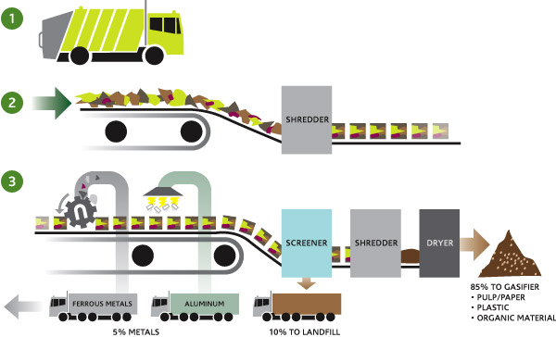

Slide 57
Incineration
Incineration is a waste treatment process that involves the combustion of organic substances contained in waste materials.
Incineration and other high temperature waste treatment systems are described as "thermal treatment".
Incineration of waste materials converts the waste into ash, flue gas, and heat.
Incinerators are used for this process.

Slide 58
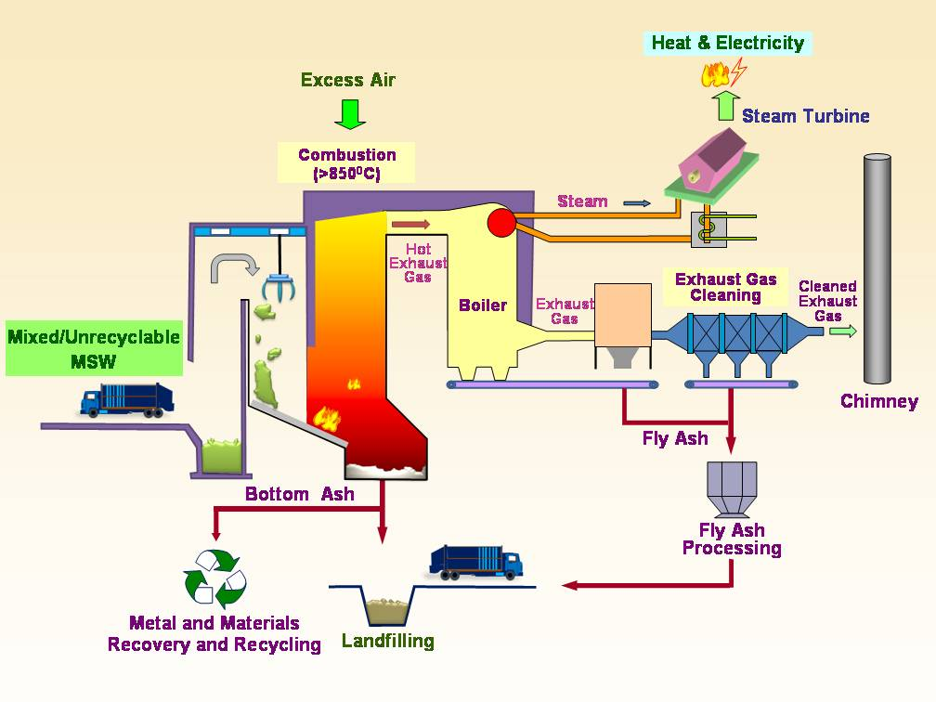

Slide 59
Important points regarding incineration
Supplying of solid waste should be continuous.
Waste should be proper mixed with fuel for complete combustion.
Temp. should not less than 670 ˚C.

Slide 60
Advantages
Most hygienic method.
Complete destruction of pathogens.
No odor trouble.
Heat generated may be used for steam power.
Clinkers produced may be used for road construction.
Less space required.
Adverse weather condition has no effect.

Slide 61
Disadvantages
Large initial expense.
Care and attention required otherwise incomplete combustion will increase air pollution.
Residues required to be disposed which require money.
Large no of vehicles required for transportation.

Slide 62
Landfilling
A landfill site is a site for the disposal of waste materials by burial and is the oldest form of waste treatment.
Historically, landfills have been the most common methods of organized waste disposal and remain so in many places around the world.
The dumping is done with layers of 1- 2 m.
The layer is covered with soil of 20 cm thickness.

Slide 63
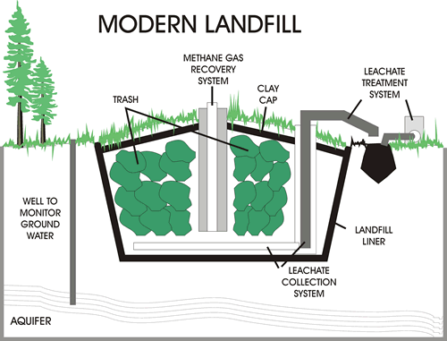

Slide 64
Advantages
Simple method.
No costly plant required.
No residues or by products need to be disposed.
Separation not required.
Unused land can be used.
Methane gas can be used ass fuel.

Slide 65
Disadvantages
Large land required.
Proper dumping site may not be available.
Odor problem.
Use of insecticides required.
Leachate should be collected regularly.
Methane gas should be collected properly.
Green house gas problem.

Slide 66
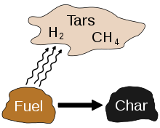
Pyrolysis
Heating of the solid waste at very high temp. in absence of air.
Carried out at temp. between 500 ˚C – 1000 ˚C.
Gas, liquid and chars are the by products.

Slide 67
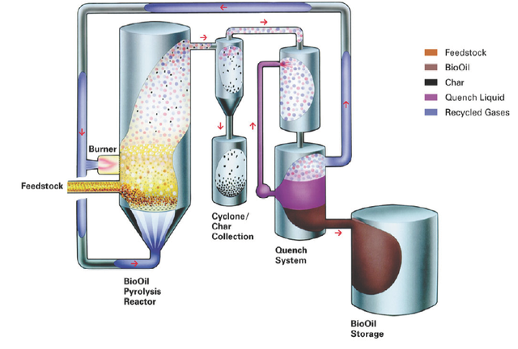

Slide 68
Recycling
Recycling is processing used materials into new products .
It reduce the consumption of fresh raw materials, reduce energy usage, reduce air pollution (from incineration) and water pollution (from landfilling).
Recycling is a key component of modern waste reduction and is the third component of the "Reduce, Reuse, Recycle" waste hierarchy.

Slide 69
Recyclable materials include many kinds of glass, paper, metal, plastic, textiles, and electronics.
Although similar in effect, the composting or other reuse of biodegradable waste – such as food or garden waste – is not typically considered recycling.
Materials to be recycled are either brought to a collection centre or picked up from the curbside, then sorted, cleaned, and reprocessed into new materials.

Slide 70
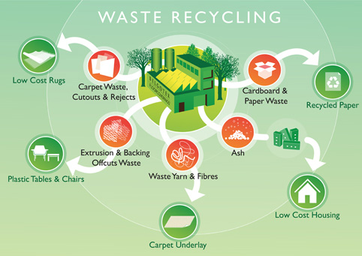

Slide 71
Thank u …

