Slide 2
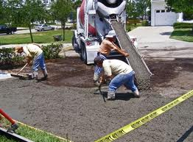
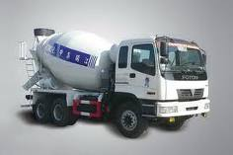
TRANSPORTATION AND PLACING OF CONCRETE

Slide 3
PRESENTED TO: DR. AYUB ELAHI
ORGANIZED BY:
Mudassar ghumman
Muhammad Subhan
Aoon Muhammad
Muhammad Imran
Khurram shahzad

Slide 4
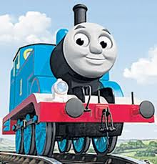
Transportation and placing of concrete process
BATCHING
Batching is the process of measuring concrete mix ingredients by either mass or volume and introducing them into the mixer.

Slide 5
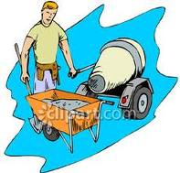
MIXING OF CONCRETE
All concrete should be mixed thoroughly until it is uniform in appearance, with all ingredients evenly distributed
Maximum allowable differences to evaluat mixing uniformity within a batch of ready mixed concrete are given in ASTM C 94 (AASHTO M 157).

Slide 6
TRANPORTATION AND PLACING OF CONCRETE ????????

Slide 7
Transporting of concrete:
Transporting is that process in which concrete is achieve from a concrete batching plant or any where such as(concrete mixer,hand mixing place,etc) and transport on working place on construction site.

Slide 8
Placing of concrete:
Freshly made concrete are poured in formwork or its final position is called placing of concrete

Slide 9
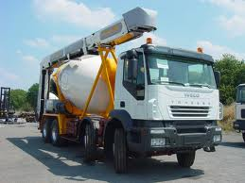

Slide 10
METHODS AND EQUIPMENTS?
METHOD?
EQUIPMENT?
????????

Slide 11
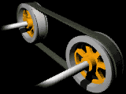
Belt conveyer
METHOD
Conveyor belt unit used alternatively for bed as well as slope position, with minor alteration in the pin connected bolted structure - High production capability will spread up to 35 CuMt per hour with constant concrete supply and suitable site condition

Slide 12
- Conveyor with standard flange wheel runs on rail, Travel speed of each end is controlled separately. This negotiate the curves easily - The conveyor can also run bank to bank on smaller canal with suitable shute to place concrete from the canal height.

Slide 13
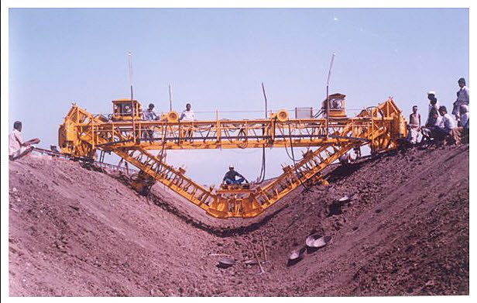
Heavy duty pavers for concrete slabs : canal and reservoir

Slide 14
Belt conveyer mounted on truck mixers
METHOD
The Belt conveyer is attached with truck. The truck have different capacities of one batch of concrete.
The belt conveyors are driven by a hydraulic transmission in vertical position capable of turning 280° around their axis, facilitating their positioning , even on uneven ground. During the distribution, the truck must remain parked in the area where it is positioned

Slide 15
The speed of the conveyor is independent of the vehicle that carries the mixer or of the auxiliary motor, as it is provided by a hydraulic fixed displacement motor connected to the conveyor drive roller, which in turn is driven by a hydraulic pump connected to the power takeoff of the vehicle transmission.
Made of steel
Easily and immediately distribute, at the desired point.
Ideal for building of foundations, small floors, concrete pillars and road works.
Driven up to 12 m

Slide 16
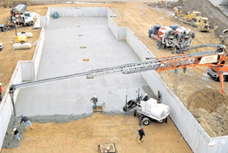
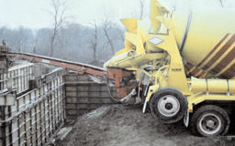

Slide 17
Buckets
METHOD
Aluminum and steel concrete buckets of different shapes and capacities starting from 4 ft³ (100 l) up to 6 yd³ (4.6 m³). Custom buckets and hoppers.

Slide 18
Used with cranes, cableways and helicopters for construction of buildings and dams. Convey concrete directly from central discharge point to formwork or to secondary discharge point
Don’t load more above there capacity
Don’t stay under it

Slide 19
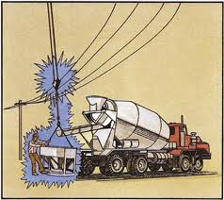
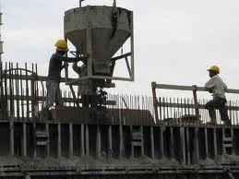

Slide 20
Concrete truck mixer Chutes
METHOD
Concrete truck mixer is used for transit the ready mixed concrete from concrete batching plant or mixing factory to constrution site .
charged with dry materials and water, with the mixing occurring during transport, the mixing bin is driven by a hydraulic motor with power take off from the engine of truck mixer, about 12-16rpm

Slide 21
From the truck it may go onto chutes to guide the viscous concrete directly to the job site. If the concrete truck mixer cannot get close enough to the site to use the chutes, the concrete may be discharged into a concrete pump connected to a flexible hose, or onto a conveyor belt which can be extended some distance. Boom pumps are also work with concrete truck mixers, a boom pump provides the means to move the material to precise locations, multi-floor buildings, and other distance prohibitive locations.
Segregation
Not more inclind

Slide 22
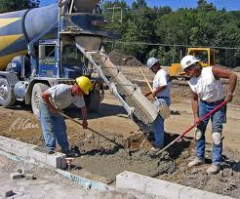
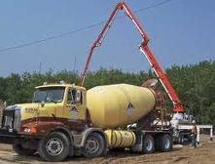

Slide 23
Pumps
METHOD
Used to convey concrete directly from central discharge point at jobsite to formwork or to secondary discharge point
Types =2
First attach to truck known as a trailer-mounted boom
mounted on a truck and known as a truck-mounted concrete pump
Move concrete over relatively long distances. Up to 8 m (25 ft)s
Pipelines take up little space and can be readily extended.

Slide 24
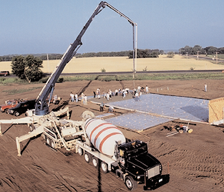
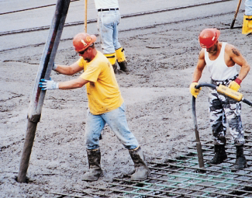

Slide 25
Buggies
METHOD
A concrete buggy is a type of ride-on equipment used to transport heavy materials.
Though its name indicates its common use for mixing concrete, a concrete buggy has a variety of uses.
Uses
For concrete, a concrete buggy is used to deliver and move a small load of ready-mix concrete. It can also be used for landscaping purposes, such as moving fill.

Slide 26
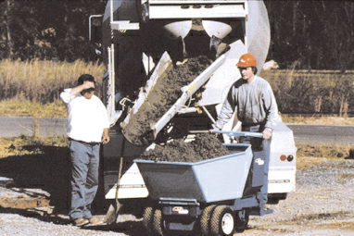
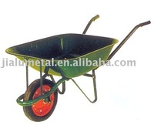
Benefits
Because of their small sizes, concrete buggies can access many small spaces, and because they run on gasoline, they allow you to move materials more quickly. Concrete buggies also reduce your risk of injury while performing a job because there is no heavy lifting involved.

Slide 27
Pneumatic guns (shotcrete)
METHOD
Used where concrete is to be placed in difficult locations and where thin sections and large areas are needed

Slide 28
Shotcrete is concrete (or sometimes mortar) conveyed through a hose and pneumatically projected at high velocity onto a surface, as a construction technique.
Shotcrete undergoes placement and compaction at the same time due to the force with which it is projected from the nozzle. It can be impacted onto any type or shape of surface, including vertical or overhead areas.

Slide 29
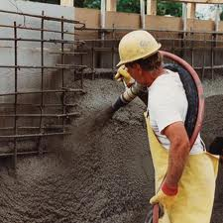
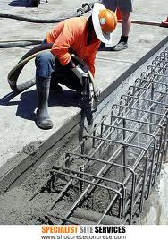

Slide 30
Tremie
In the Tremie Concrete method, concrete is placed below water level through a pipe, the lower end of which is kept immersed in fresh concrete so that the rising concrete from the bottom displaces the water without washing out the cement content.
The tremie concrete method is often used in bridges that span bodies of water. In this case, the pier footing is supported by a tremie. Tremie pipes are also used to pour the concrete in slurry walls.

Slide 31
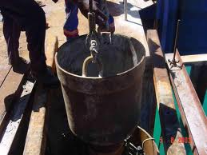
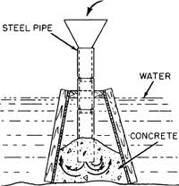
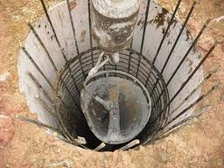

Slide 32
Choosing the Best Method
The first thing to look at is the type of job, its physical size,the total amount of concrete to be placed, and the time schedule. Studying the job details further will tell how much of the work is below, at, or above ground level. This aids in choosing the concrete handling equipment necessary for placing concrete at the required levels.

Slide 33
Work Above Ground Level
Conveyor belt, crane and bucket, hoist, pump, or the ultimate sky-hook, the helicopter, can be used for lifting concrete to locations above ground level The tower crane and pumping boom are the right tools for tall buildings.

Slide 34
Work At and Below Ground Level
The largest volumes of concrete in a typical job usually are either below or at ground level and therefore can be placed by methods different from those employed on the superstructure. Concrete work below ground can vary enormously—from filling large-diameter bored piles or massive mat foundations to the intricate work involved in basement and subbasement walls. A crane can be used to handle formwork, reinforcing steel, and concrete.

Slide 35
Possibly the concrete can be chuted directly from the truck mixer to the point needed. Chutes should be metal or metal lined. They must not slope greater than 1 vertical to 2 horizontal or less than 1 vertical to 3 horizontal. Long

Slide 36
Thanks

